Slide 1
Lawn Care Assistant
Aditya Shelke, Pranav Anthapu

Slide 2
Modifications to Design Review Presentation #1
After meeting with ECET advisor from Lockheed Martin
End user customer definition is more specialized. Now, the end user is specifically homeowners with less than 5,000 square feet worth of rectangular lawn area, whereas it was all homeowners with lawns before.
Slide 8, which is the slide about which fertilizer we are using, was newly added to provide more information about how much fertilizer is needed for 5,000 square feet.
To accommodate 5,000 square feet worth of fertilizer, the width of the container was increased to 10.5 inches from 8 inches prior. This leads to a carrying capacity of 756 in.³ without including the lost space due to the ramp, which is negligible. This robot will thus carry 12.6 pounds of fertilizer.

Slide 3
Modifications to Design Review Presentation #2
After meeting with ECET advisor from Lockheed Martin
Some additional calculations in regard to maximum runtime and runtime required for 5,000 square feet in order to provide a clearer picture of the robot’s functionality.
The maximum runtime is 13.4 hours.
The runtime for 5,000 square feet is less than 3 hours.

Slide 4
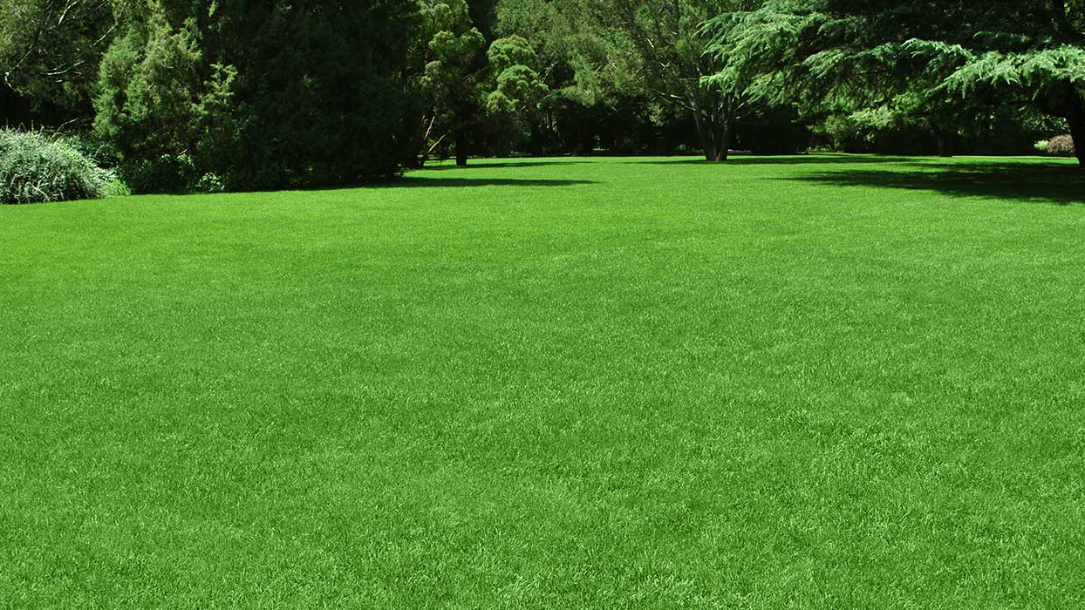
Problem Addressed
For many people, lawn / yard work takes more time than they are willing to put in. The work can easily be done by an autonomous robot, leaving the user to do whatever else they might want to do in that time.

Slide 5

Idea
Our innovation is a robot that takes care of a user’s lawn fertilizing multiple times per year without much input from the user.
The user must provide the dimensions of the yard, and the robot will go around the yard, spreading fertilizer evenly across the field.
The user can provide these dimensions on our Android application, and will be given the exact location in the lawn to place the robot for its starting location.

Slide 6
Applications
Used on fields around 5000 square feet or under in <2.91 hrs, due to size of the fertilizer container and optimal run-time
If someone is busy or does not have time to feed their lawn fertilizer multiple times a season, the robot will do it for them. All they must do is fill up the container, take the batteries off charging, and place the robot.

Slide 7
End User Customer
Product is meant for homeowners with up to 5,000 square feet of lawn area who are incapable of doing their yard work. This can be if they are either busy at all times, cannot pay an outside company to do their yard work for them, or just want to have a robot that can do their work for a one-time cost.

Slide 8
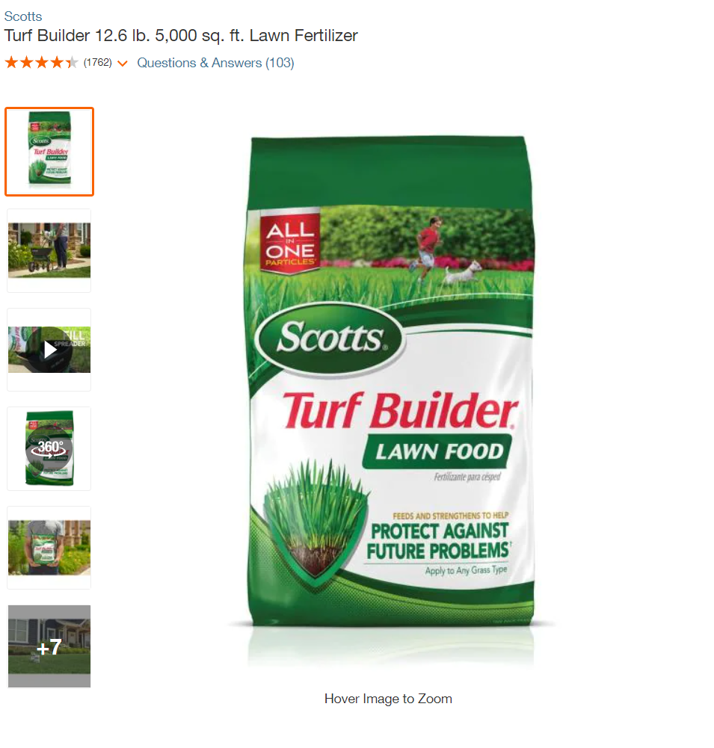
Lawn Fertilizer Being Used For Testing and by End User
Fertilizer Product Name:
Scotts Turf Builder 12.6 lbs. 5,000 square foot Lawn Fertilizer.
Specifications for 5,000 square feet:
Volume: 624 cubic inches, 0.36111 cubic feet
Weight: 12.6 pounds

Slide 9
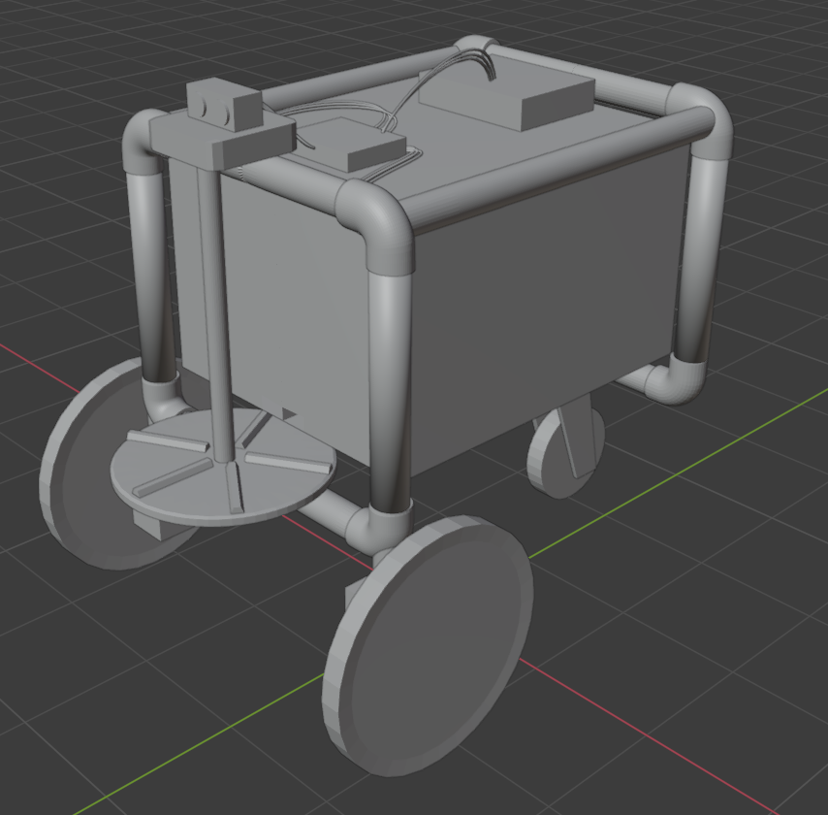
Conceptual Diagram - Labeled Version
Ultrasonic Sensor (Recognizes Obstacles and Stops Robot)
Batteries (power the robot)
Spreader Fan
(once fertilizer is dropped from container, it falls onto rotating spreader fan)
Raspberry Pi 4 (controls servos, ultrasonic sensor, makes decisions)
PVC Piping
(forms the frame of the robot and provides body support for other components)
Fertilizer Container (stores fertilizer, has a sloped shape inside so that fertilizer falls towards the hole above the spreader fan)
Gearboxes for Servos (power two front wheels and spins rod connected to spreader fan)
Latch from where fertilizer falls onto spreader fan
Caster wheel (not powered by motors, free moving)

Slide 10
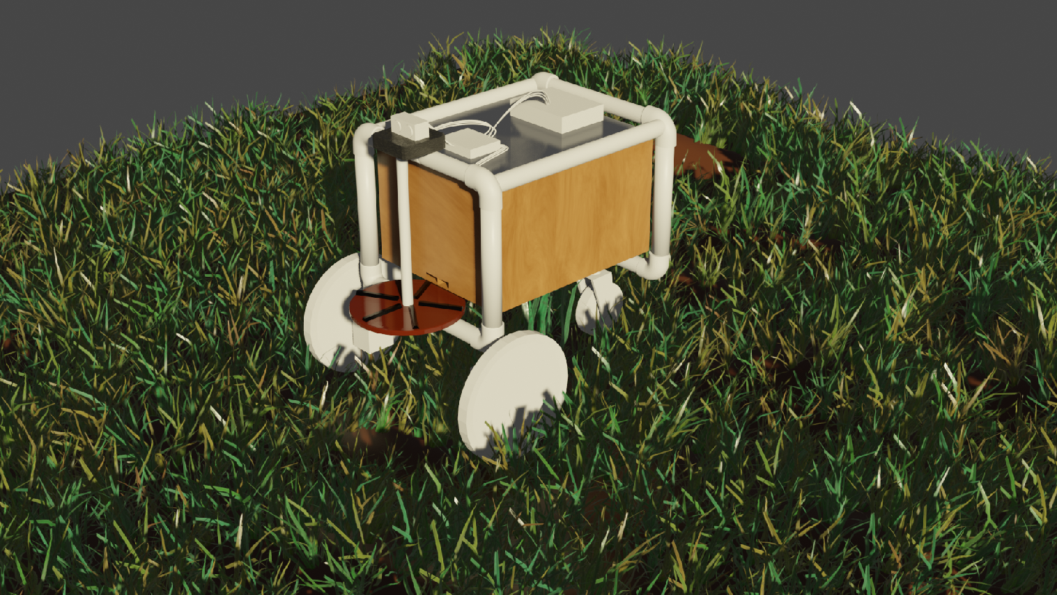
Conceptual Diagram - Rendered Version
Materials Overview:
- PVC piping for frame
- Wood for the container
- Rubber on outsides of all three wheels
- Metal casing for gearboxes for servo as well as gearboxes
- Rubber for wiring
- Metal connector for connecting caster wheel to rest of frame (back of robot)
- Metal Screws to connect container to frame
Back of Lawn Care Assistant Robot
Front of Lawn Care Assistant Robot

Slide 11
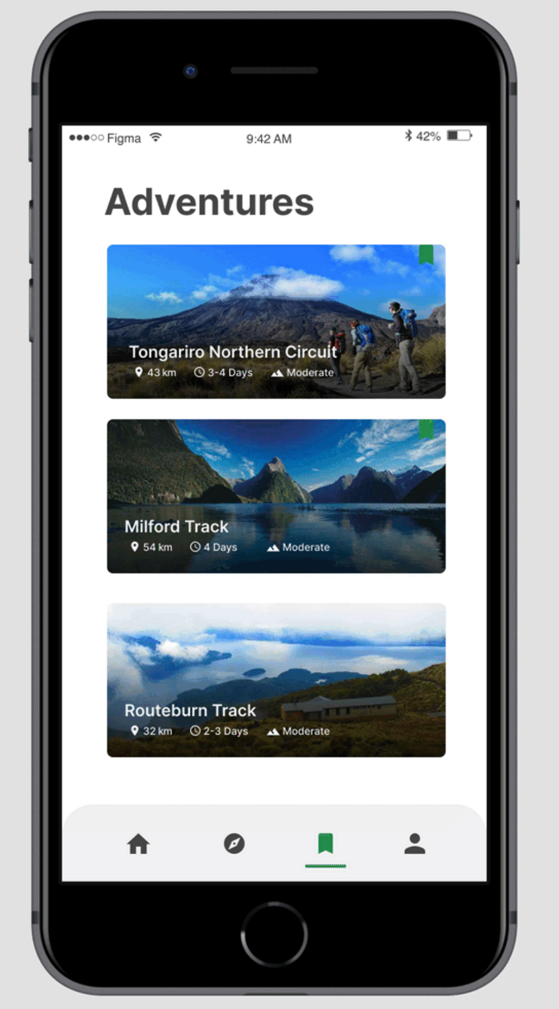

Conceptual Diagram - Android App
Remember, life is good… especially in Virginia.
START
x
Enter Dimensions
(feet)

Slide 12
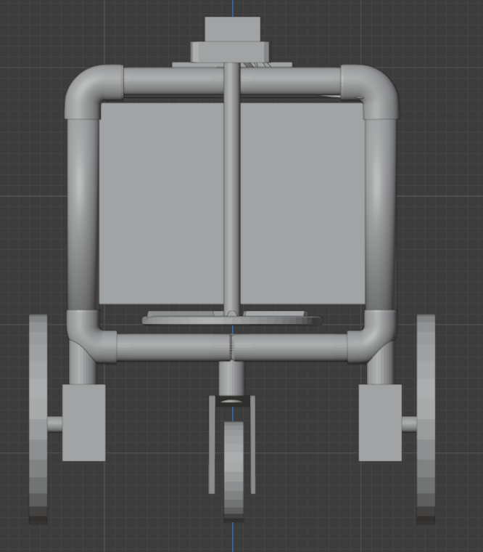
Design and Mechanical Specifications - Front
14 inches Robot Chassis Width
10.5 inches Container Width
4.5 inches spreader fan diameter
6 inch Fertilizer Hopper
0.84 inch diameter piping
Height of robot, 15 inches
1.37 inch gearbox
6 inch diameter wheels
3 inch diameter wheels
2.28 inch gearbox

Slide 13
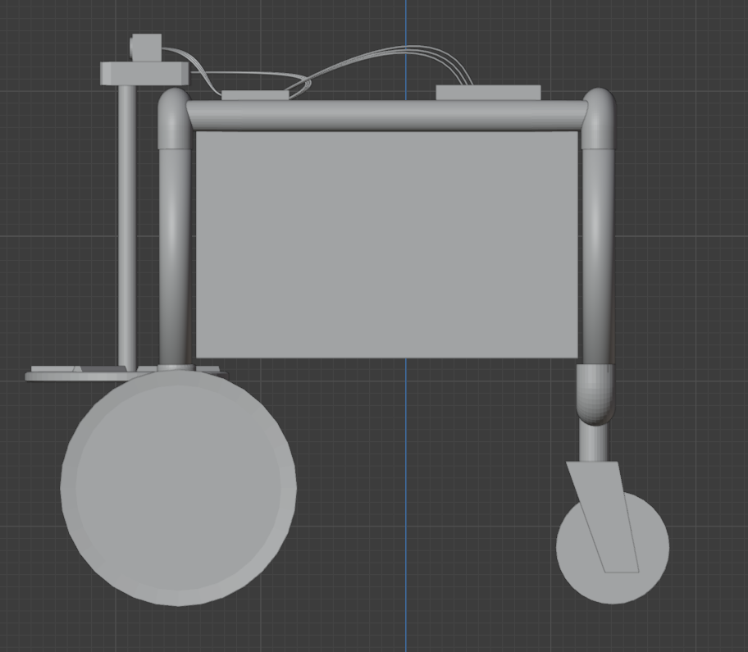
Design and Mechanical Specifications - Side
14 inch Chassis Length
0.4 inch diameter rod
12 inch Hopper Length
6 inch diameter wheels
3 inch diameter wheels

Slide 14
Design and Mechanical Specifications - Inside of Container (Cross Section)
USED AREA
6 inches height
UNUSED AREA
1 inch
7.83 degrees angle
12 inches length
Container size: 10.5 inches width x 12 inches length x 6 inches height = 756 in.³
3/32 inch width latch

Slide 15
Design and Mechanical Specifications - Additional
3D Printing Requirements: Will need to 3D print the spreader fan disk, ½” thickness, 4.5 inch diameter to spread the fertilizer / lawn food.
Optional 3D Printing Requirements: We might, if we have time, 3D print a cover for the electronics, so that the electronics are more unlikely to get wet.

Slide 16
Patent Search
First Patent: Robot that moves, with caster wheel in front and hydraulic arms on the side -- meant for agriculture but can be for different purpose.
https://patft.uspto.gov/netacgi/nph-Parser?Sect1=PTO2&Sect2=HITOFF&p=1&u=%2Fnetahtml%2FPTO%2Fsearch-bool.html&r=47&f=G&l=50&co1=AND&d=PTXT&s1=fertilizer&s2=spreader&OS=fertilizer+AND+spreader&RS=fertilizer+AND+spreader
Second Patent: Manual Granule Spreader, with a wheel and handlebar, and a hopper. Also has a spreading roller, to spread the granules into the soil evenly.
https://patft.uspto.gov/netacgi/nph-Parser?Sect1=PTO2&Sect2=HITOFF&p=1&u=%2Fnetahtml%2FPTO%2Fsearch-bool.html&r=43&f=G&l=50&co1=AND&d=PTXT&s1=fertilizer&s2=spreader&OS=fertilizer+AND+spreader&RS=(fertilizer+AND+spreader)

Slide 17

Patent Search — Value Added
The patents we found are the ones most related to our project, and are both manual.
The first patent describes a robot used for another agricultural process, and overlaps with our product only in wheel design, not functionality. It does not have any fertilizer spreading function.
The second patent describes a system for manual fertilizer spreading.
We have added the features of being autonomous and also equally spreading fertilizer.

Slide 18
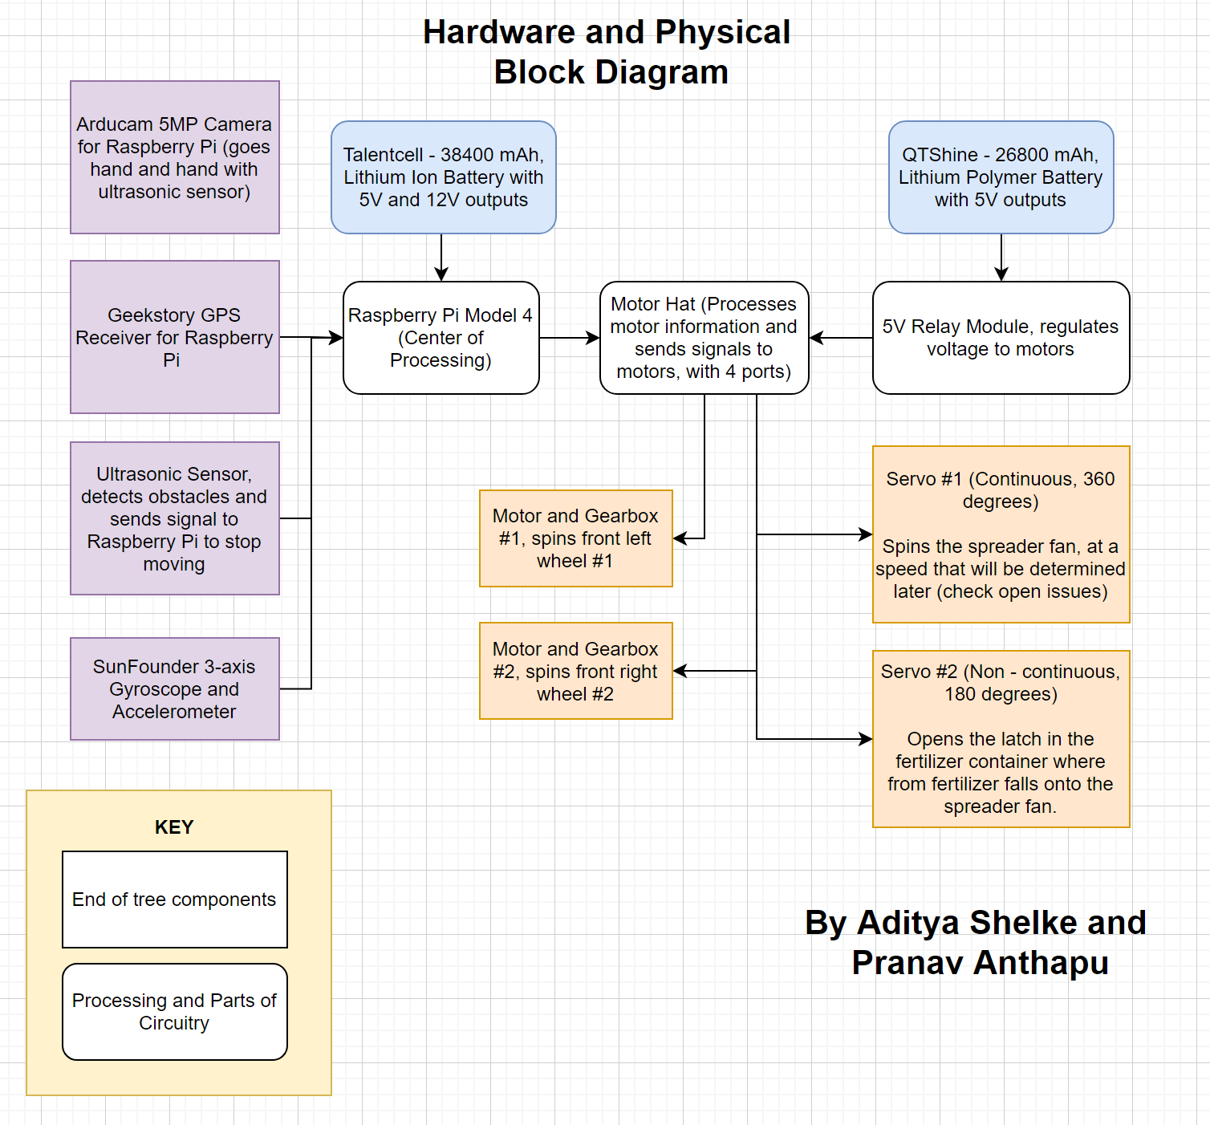
Hardware and Physical Block Diagram and Functional Description
Gets relative position from satellite
Measures acceleration, speed of robot
All other functional descriptions within block diagram itself

Slide 19
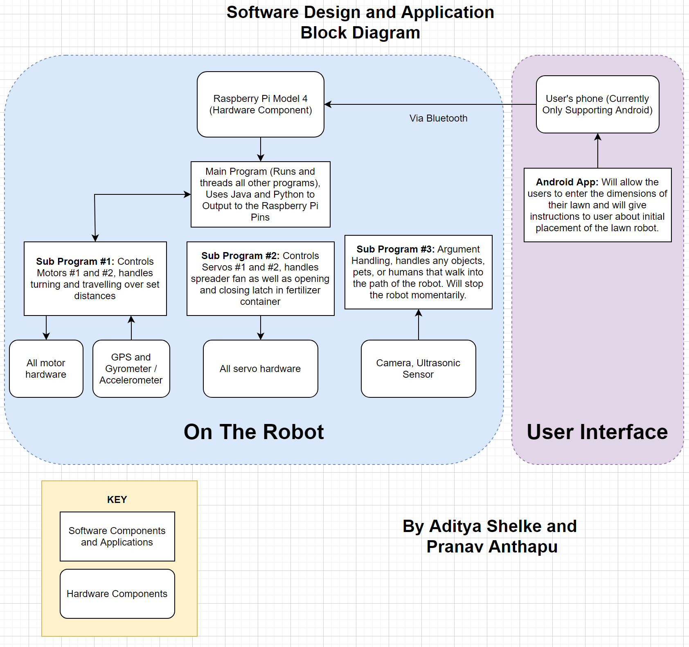
Software Design and Application Block Diagram and Functional Description
All functional descriptions within block diagram itself

Slide 20
Calculations for maximum run-time (not for 5,000 square feet)
Raspberry Pi 4 Model B(8GB) Wattage, and two servos are very minimal wattage compared to motors.
Battery powering motor has 134 Wh rating, motors need 20 watts(at full speed). That will result in 6.7 hours at full speed, multiplied by a factor if we go lower than full speed, and wheels are 7 inches in diameter
Rated torque of motors= 8 kg-cm = 6.94 lb-in, 17.8lb/6.94 = 2.56, 80/2.4 = 31.25. 31.25/2 = 15.63. 15.63rpm*6.7hrs*2*60 min*7pi/12in *1ft=23021.98 feet, in 13.4 hours

Slide 21

Weight of Robot
Without Fertilizer: 5.2 lbs
With fertilizer = 17.8 lbs

Slide 22
Concurrent Engineering
Software / Wiring (Electrical / Computer):
Object detection using the ultrasonic sensor
Moving forward / turning
Wiring servos and motors to motor hat, 5V relay, and raspberry pi
Writing programs and subprograms, creating Android App
Hardware (Civil / Mechanical):
3D Printing Disk and possibly Electronics cover, Mounting Electronics
Mounting Wheels, Motors, Attaching PVC pipes together, Mounting Servos, Building Hopper

Slide 23
Team Responsibilities
Aditya
Pranav
- Programming turning capabilities in software using Java and Python
- Programming servos for spreader fan as well as latch to allow fertilizer to leave the fertilizer container
- Programming and testing capabilities to travel a specific distance accurately using inputs from accelerometer / gyrometer
Both
- Programming algorithm to generate the path and sequence of steps that the robot needs to take based on user given dimensions
- Programming subprogram for argument handling, such as object detection and having the robot stop if there is an obstacle in the path
- Building android app and interfacing it through bluetooth with the Raspberry Pi, handling bluetooth input into the Raspberry Pi
- Robot Design
- Working on design review
- Robot assembly, drivetrain, frame building, wiring
- Last minute system testing

Slide 24
Milestones and Deliverables
Nov 18, 2021: Present Design Review by this date.
Jan 31, 2022: Finish Robot Assembly, all mechanical aspects of the project. All wiring of the parts should be done.
Apr 6, 2022: Finish all subprograms and main program that will be run in the Raspberry Pi. This includes the Android app.
May 18, 2022: Be Ready to Demo
MP2 Deliverable:
Drivetrain of robot, with all wiring done
MP3 Deliverable:
Robot’s Programming
MP4 Deliverable:
Robot fully tested, Demo Version

Slide 25
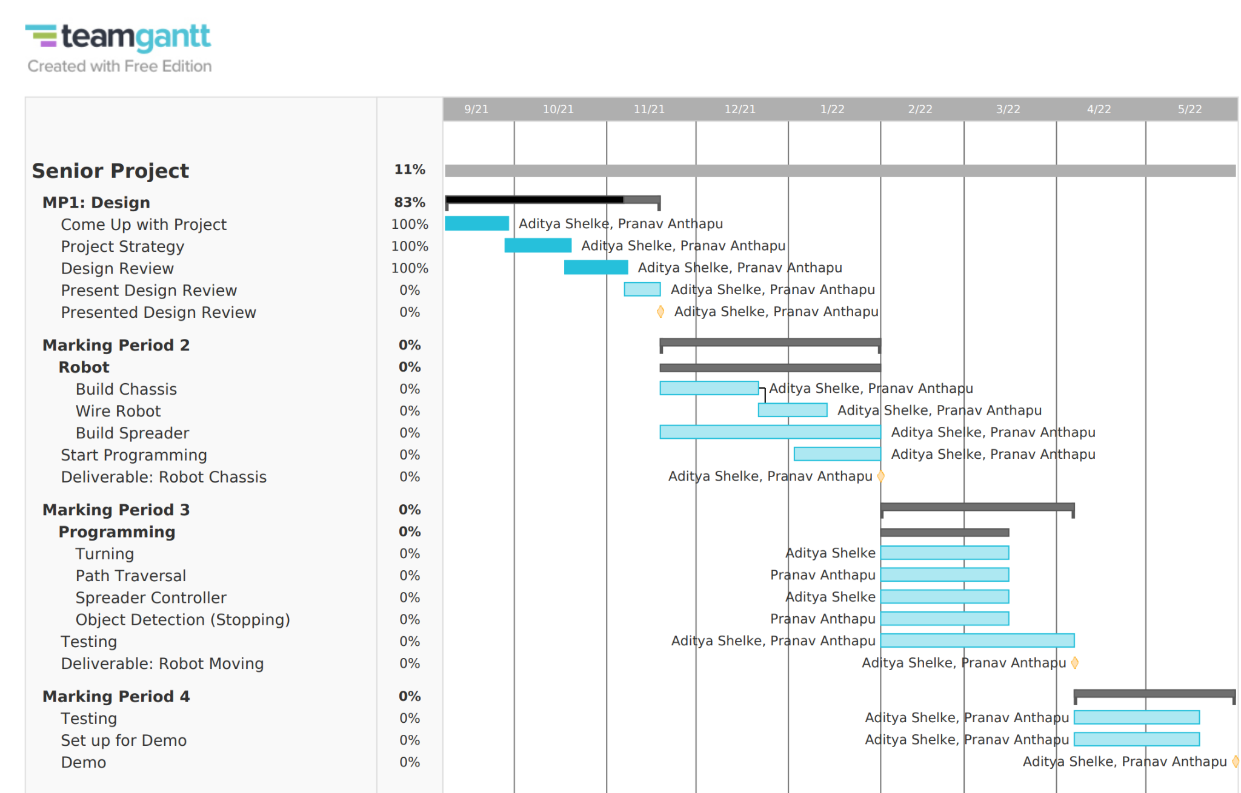
Gantt Chart

Slide 26
BOM Analysis
Item # | Part # | Ref. Des. | Primary Source | Part Desc. | Lead Time | Cost/ Unit | Total Cost | On Hand
1 | PB120B1 | A | Amazon | 12v, 142.08 Wh battery | 4 months | $91.39 | $91.39 | Yes
2 | MBB-01-05 | B | Amazon | Bread board | 4 months | $10.99 | $10.99 | Yes
3 | EL-CP-004 | C | Amazon | Jumper Cables | 4 months | $6.98 | $6.98 | Yes
4 | ‎H-PVCFITTING-3-4-3WAY-4 | D | Amazon | 3 way pvc fitting | 5 months | $9.99 | $9.99 | No

Slide 27
BOM Analysis
Item # | Part # | Ref. Des. | Primary Source | Part Desc. | Lead Time | Cost/ Unit | Total Cost | On Hand
5 | 31407CP | E | Amazon | ¾ in PVC T pipe | 5 months | $10.80 | $10.80 | No
6 | PVC, SCH 40 | F | Amazon | 3 way ¾ in PVC | 5 months | $13.00 | $13.00 | No
7 | GT-U7 GPS | G | Amazon | GPS module | 4 months | $10.99 | $10.99 | No
8 | 9807E | H | Amazon | Swivel Caster wheel | 5 months | $6.94 | $6.94 | No

Slide 28
BOM Analysis
Item # | Part # | Ref. Des. | Primary Source | Part Desc. | Lead Time | Cost/ Unit | Total Cost | On Hand
9 | CanaKit | I | Amazon | Raspberry pi kit | 4 months | $154.99 | $154.99 | Yes
10 | HAT-MDD10 | J | Amazon | Pi Driver hat | 4 months | $23.38 | $46.76 | Yes
11 | OV5647 | K | Amazon | Pi Camera | 4 months | $11.99 | $11.99 | Yes
12 | HX160Y1 | L | Amazon | Battery Pack 26800 mAh | 4 months | $23.39 | $23.39 | Yes

Slide 29
BOM Analysis
Item # | Part # | Ref. Des. | Primary Source | Part Desc. | Lead Time | Cost/ Unit | Total Cost | On Hand
13 | 1280DE-S495 | M | Amazon | 12v Worm Gear motor | 5 months | $29.99 | $59.98 | No
14 | 72-107 | N | Amazon | Universal wheel 7” | 5 months | $5.54 | $11.08 | No
15 | N/A | O | Amazon | 8 mm flange shaft coupling | 5 months | $9.49 | $9.49 | No
16 | FS90R | P | Amazon | 360 degreeServo | 5 months | $19.89 | $19.89 | Yes

Slide 30
BOM Analysis
Item # | Part # | Ref. Des. | Primary Source | Part Desc. | Lead Time | Cost/ Unit | Total Cost | On Hand
17 | S03s | Q | Amazon | Ultrasonic distance sensor | 4 months | $11.59 | $11.59 | No
18 | B088GZ8ZPN | R | Amazon | 5v relay module | 4 months | $10.99 | $10.99 | No
19 | MPU6050 | S | Amazon | 3-axis gyro and accelerometer | 4 months | $9.99 | $9.99 | No

Slide 31
BOM Analysis
Item # | Part # | Ref. Des. | Primary Source | Part Desc. | Lead Time | Cost/ Unit | Total Cost | On Hand
20 | MG995 | T | Amazon | 180 degree servo, high speed | 4 months | $17.99 | $17.99 | Yes

Slide 32

Cost Analysis
Buying all parts would be about $94 outside budget
Total cost of parts: $394
However we have many parts on hand already, due to experimenting with parts in the past
Final Outlook on Budget: Parts that need to be bought will fit comfortably within budget
If it don’t fit (in the budget), don’t quit!

Slide 33
Risk Factor
Risk Factor Boundary problem: If the user specifies a particular lawn width and length, we do not know what the ideal method is to keep the robot in that area.
Our current method is to use a range of sensors, such as accelerometer and gyrometer, to accurately keep the robot from travelling too far and turn exactly 180 degrees on each pass of the lawn.
However, as the robot will be working outside, wheel slip and uneven terrain may make these turns not exactly 180 degrees and each pass of the lawn not the exact required amount, which poses problems for keeping the robot in the lawn.

Slide 34
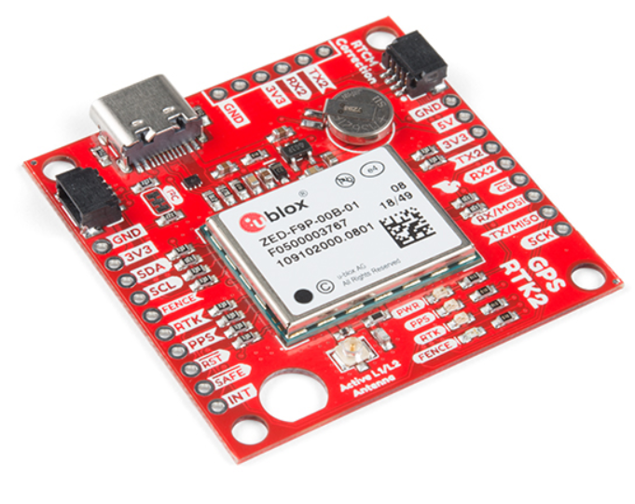
GPS - RTK Contingency Plans
Contingency Plan: GPS RTK, or Global Positioning System Real Time Kinetics, is a system that uses a base station set up miles away to improve GPS accuracy to the scale of 2 cm from the previously 2 - 3 m accuracy found in regular GPS and phones.
Very Accurate — within centimeters. Much more expensive. $274.95 for the chip, possible additional expenses such as 4G connectivity to connect to publicly available base stations may be required.
If required, we can set up our own base station, although cost for this topic will be revisited in the hopefully unneeded case we require switching to this contingency plan.
This contingency plan will help in the case our current method for solving the boundary problem does not work. By knowing the exact position of the robot at all times, it does not matter if there’s wheel slip or bad turns, the programming in the Raspberry Pi can make decisions based on the current position.
SparkFun GPS-RTK2 Board - ZED-F9P (Qwiic)

Slide 35
Risk Factor
Risk Factor Spreader Mechanism - We need a way for the servo to be attached to the robot in order to spin the spreader wheel.
Our current plan involves the servo near the other electronics, on top of the robot with a 6 inch wooden dowel or rod attaching underneath, with a wheel on the rod.
However, the rod’s height will put a lot of stress on the servo, and will require the servo to have both high torque and high speed, which our current servo planned for the issue is not built for.

Slide 36
Spreader Mechanism Contingency Plans
Contingency Plan: We will keep the servo for the spreader mechanism underneath the robot, so the servo doesn’t have any stress on it, and that all the stress of the spreader is underneath the robot, increasing stability of the robot, and bringing the center of gravity lower to the ground.
Much more stable - The servo being underneath the robot (on some sort of extension beam), will allow us to keep the spreader mechanism attached to the hopper and place it at a height that can be variable.
Might be difficult to wire the servo up to the raspberry pi, which we can use an extension or hub to connect.
This contingency plan will help in the case our current method for the spreader mechanism does not work. By keeping the servo underneath, the servos gear has a lesser chance of decaying quickly, due to there being much lower stress put on the gearbox of the servo. It also provides a variable height and diameter for the servo, rather than keeping the servo near our other electronics. It will also unclutter our electronics board.
New spreader mechanism diagram shown with Google Shapes

Slide 37
Testing Strategies
Unit Testing: Testing battery, raspberry pi and motors and servos all on their own.
Example: If motors are connected to the raspberry pi, and given power, will they spin at the right speed?
Integration Testing: Testing if robot drivetrain can even drive properly with container underneath, checking if camera + ultrasonic sensor can sense if object in way
Example: Add all motors and components to the robot frame. Will each system (object detection, movement, and spreader operation) work separately?
System Testing will be outside in March and April, to see if all individual features can work together.

Slide 38
Testing (All Testing)
Unit Testing:
Will motors spin at right speed?
Will servos spin / (open and close) at right speed?
Does ultrasonic sensor work?
Does bluetooth connection from phone to Raspberry Pi work?
Does the android app take input correctly?
Does the gyroscopic sensor and accelerometer and GPS send data to the Raspberry Pi?
Integration Testing:
Will the program running in the Raspberry Pi drive the motors? Will it drive the servos?
Will the program be able to make decisions based on hardware and sensor inputs and send those decisions to the motors?
Integration Testing:
Will all systems work?
If the new user tries out the system, will it work flawlessly and not leave the boundary of the lawn?

Slide 39
Open Issues
Length of Rod that Spreader wheel is attached to: We need to do some math to figure out exact size
Speed of Spreader Fan (RPM): Testing will need to be done to figure out the best speed for spreading the fertilizer.

Slide 40
Resource Requirements
Software - Raspberry Pi, Android Studio
Reuse libraries we have found for device interactions with Pi
Create Android App
Languages: Java/Python
Hardware: equipment we will need to assemble is 3D printer and saws
Troubleshooting: no extra equipment needed.
We will use 2 rechargeable battery packs to have a run-time of approximately 20 minutes

Slide 41
References
http://www.robotplatform.com/knowledge/Classification_of_Robots/Types_of_wheeled_robots.html
https://robotics.stackexchange.com/questions/22799/what-is-the-most-cost-effective-yet-still-reliable-outdoor-boundary-system
https://tutorials-raspberrypi.com/raspberry-pi-sensors-overview-50-important-components/#motion

Slide 42
Acknowledgements
Mr. Santosh Xavier
Mr. Uday Singh
Both have been helpful to our project, as they have helped us gain insight on the boundary problem that we were facing earlier.
Thank you to free 3D modeling software Blender 2.92, for allowing us to design our conceptual designs and mechanical designs.

